Slide 1
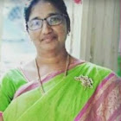
KNOWLEDGE AND CURRICULUM
Unit III - Child Centred Education
Dr.V.Regina
Principal ,Asst,Professor of Biological Science
CSI Bishop Newbigin College of Education
No.109, Dr.Radhakrishnan salai, Mylapore, Chennai - 600004

Slide 2
Synopsis
Definition
Characteristics of child centred education
Educational thoughts of Mahatma Gandhi
Educational thoughts of Rabindranath Tagore
Educational thoughts of Plato
Educational thoughts of Martin Buber
Educational thoughts of Paulo Freire
Educational thoughts of John Dewey
Conclusion
Suggested Readings
Freedom
Self-activities
Process of spontaneous development
Development of interest and needs
Education based on experience
Dr. V. Regina , Principal CSI BISHOP NEWBIGIN COLLEGE OF EDUCATION

Slide 3
Learning Objectives
To improve in students learning programmes by themselves
To implement students needs and requirements
To encourage to actively search for knowledge and to carry out complex learning activities
Inspire students to explore what they are most curious about.
Learner directs their own learning fostering a curiosity that will stick with them for life.
Every learner response better to a different learning styles
Learning Outcomes
Dr. V. Regina , Principal CSI BISHOP NEWBIGIN COLLEGE OF EDUCATION

Slide 4
Mahatma Gandhi:
Education should be of developing the integrated personality of the child (life centred).
Rabindranath Tagore:
Education should be of gradual and progressive growth of a child.
Plato:
Education should be of welfare of both the child and the society.
Martin Buber:
Education should be of community and important thinker for educators.
Paulo Freire:
Education should be of child with a lot of “Rote - learned “ information.
John Dewey:
Education should be of individual needs of the child.
Definition
Student - Centred education or learner-centred education is also called child - centred education is an approach to education which focus on the needs of the students, rather than those of others involved in the educational process such as teachers and administrators.
Dr. V. Regina , Principal CSI BISHOP NEWBIGIN COLLEGE OF EDUCATION

Slide 5
Characteristics of Child- centred education
3.Education:
The fundamental right every child is education , no matter whatever is his social and economic background.
4.Curriculum, syllabus, teaching:
Organised in accordance with the needs and interests of children.
5.All round Development of child :
Child-centered aims at total, all round development of children, which leads to his/her cognitive, affective & cognitive development.
1.Dignity of the Child:
The spirit of child-centred education upholds the dignity of the child in the academic and social fabric such a system of education gives due respect to individuality of the child.
2. No Discrimination:
Child-Centred education is above caste, creed, sex and education is above caste, creed, sex and economic and social background of the child. There is no place for discrimination of any kind in child-centred education.
Dr. V. Regina , Principal CSI BISHOP NEWBIGIN COLLEGE OF EDUCATION

Slide 6
Characteristics of Child- centred education
6..Positive discipline:
Child centred education condemns corporal punishment and enforcing rules of discipline, child’s dignity and individuality must be respected.
7. Condition Evaluation:
Child’s deficiencies are identified and remedial measures are instituted in progressive manner.
8.Helping every child to acquire minimum level of learning:
A Teacher making use of child-centered approach ensures that each and every child acquires the minimum level of competencies in all the subjects,
9. Not self- pedagogy:
Child centred ethos in the school under which child’s right to education must be recognised.
10. The teacher is important too:
Child-centered approach to education in no way minimises the important of the teacher.
Dr. V. Regina , Principal CSI BISHOP NEWBIGIN COLLEGE OF EDUCATION

Slide 7
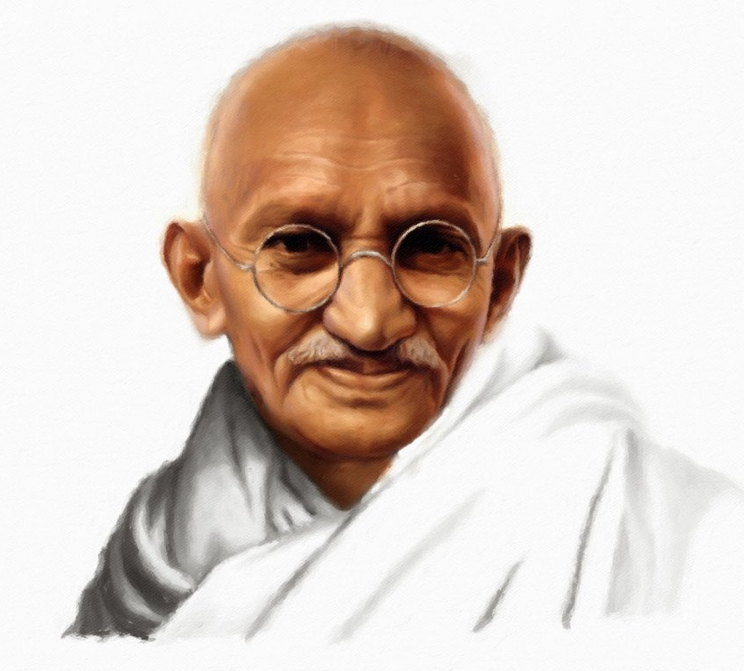
Educational Thoughts of
Mahatma Gandhi
Education for life, through life throughout life.
Truth, non-violence, fearlessness satyagraha. Self - realization total personality.
To achieve mental development training of senses and parts of the body should be given.
Reading should precede the teaching of writing.
Basic education: He mainly aims at the education in mother tongue
To make the children skilled and independent
Education is a harmonious blending of idealism, nationalism and pragmatis.
Dr. V. Regina , Principal CSI BISHOP NEWBIGIN COLLEGE OF EDUCATION

Slide 8
Educational Thoughts of
Mahatma Gandhi
Education for life, through life throughout life.
Truth, non-violence, fearlessness satyagraha. Self - realization total personality.
To achieve mental development training of senses and parts of the body should be given.
Reading should precede the teaching of writing.
Basic education: He mainly aims at the education in mother tongue
To make the children skilled and independent
Education is a harmonious blending of idealism, nationalism and pragmatis.
Dr. V. Regina , Principal CSI BISHOP NEWBIGIN COLLEGE OF EDUCATION

Slide 9
Educational Thoughts of
Mahatma Gandhi
Education should employ some craft as a medium of education so that the child grains economic self-reliance for his life.
Education should develop human values in the child
Education should create useful,responsible and dynamic citizens.
Education should achieve the harmonious development of child’s body, mind, heart and soul.
7 to 14 years of age, education of each child should be free, compulsory and universal
The medium of instruction should be their own mother tongue
Mere literacy cannot be equated with education.
Dr. V. Regina , Principal CSI BISHOP NEWBIGIN COLLEGE OF EDUCATION

Slide 10
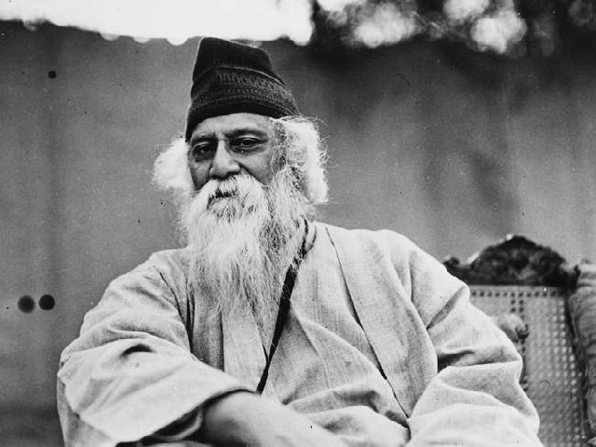
Educational Thoughts of
Rabindranath Tagore
Living ideals cannot be set into clockwork arrangement.
The teacher is Guru
Mother tongue must be the medium of instruction.
There is well- equipped library.
Education is short of the highest purpose of man,the fullest growth and freedom.
The objective of education is the freedom of mind which can only be achieved through the path of education.
Children's subconscious mind is more active than their conscious intelligence.
Dr. V. Regina , Principal CSI BISHOP NEWBIGIN COLLEGE OF EDUCATION

Slide 11
Educational Thoughts of
Rabindranath Tagore
Love for humanity : education should teach people to realise oneness.
Freedom : Education is a man - making process.
Correlation of objects: a peaceful world is only possible when correlation between man and nature will be established.
Moral and spiritual development
Social development : Brotherhood should be cultivated from the beginning of life
Self - realisation - spiritual is the essence of humanism.
Intellectual development- development of imagination, creative, free thinking, constant curiosity alertness of the mind.
Physical development- sound and healthy physique through yoga , games
Dr. V. Regina , Principal CSI BISHOP NEWBIGIN COLLEGE OF EDUCATION

Slide 12
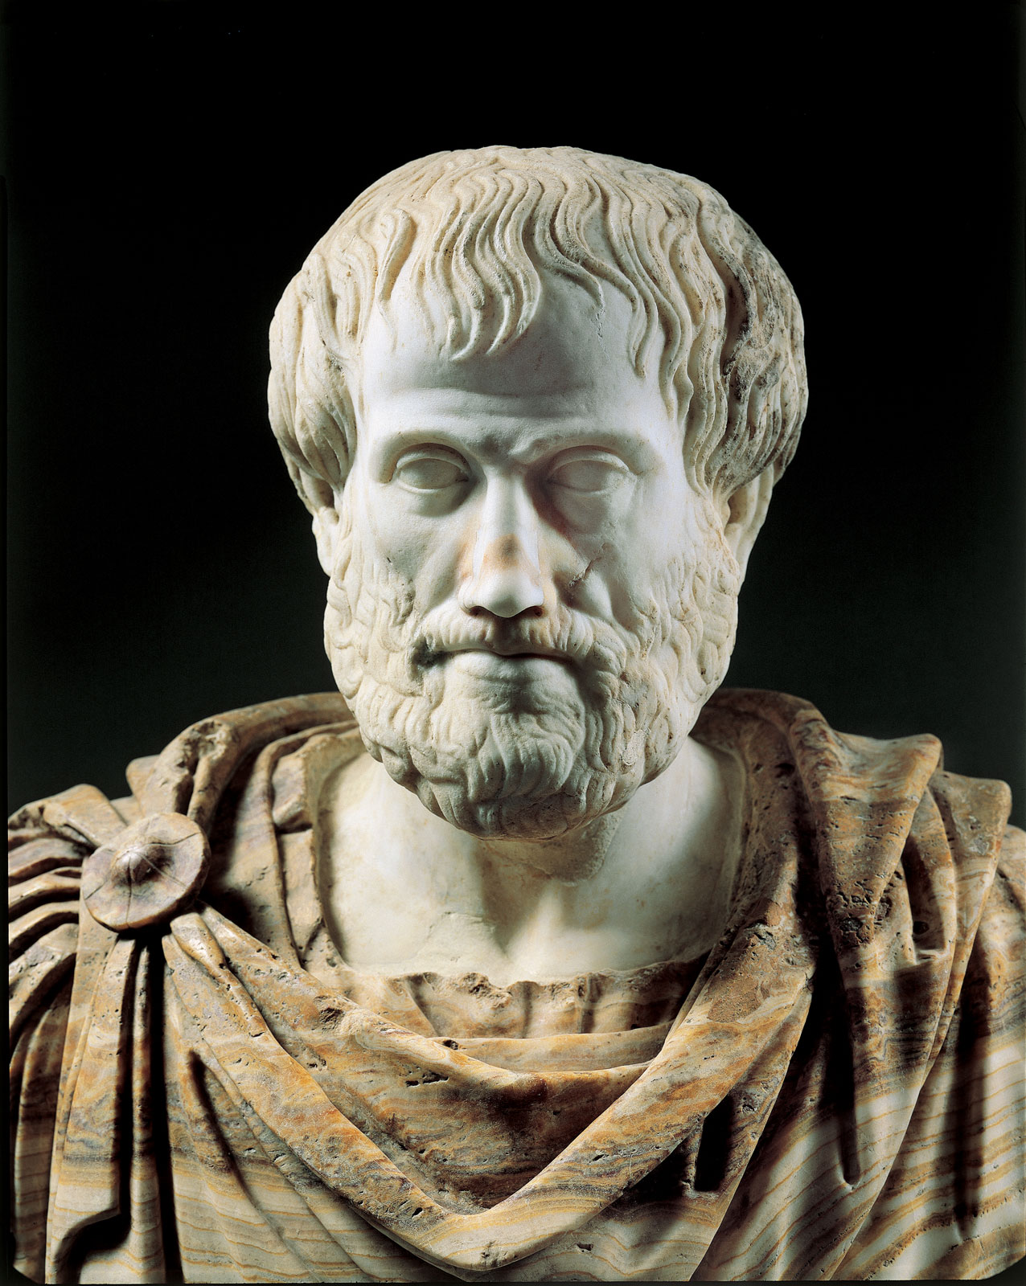
Educational Thoughts of Plato
Knowledge of good, to nurture a man to a better human being, it is not merely an awareness of particular benefits and pleasures.
Education must begin at the age of seven..
Ethics is the most important branch of philosophy, ethical education was his motto.
To develop leader among the future rulers.
To develop hard and competent workers
To produce leaders with military skill among warriors.
To produce future civil servants of the state.
Dr. V. Regina , Principal CSI BISHOP NEWBIGIN COLLEGE OF EDUCATION

Slide 13
Educational Thoughts of Plato
Women education - women are equal to men.
Learning by doing was the teaching method.
Knowledge which is acquired under compulsion obtains no hold on the mind.
A child should play amongst lovely things.
Elementary school till the age of 18 with music , literature , poetry and mathematics.
Military training - after elementary two years of physical education should be given.
Higher education - 20 to 25 years is an indispensable necessity of humankind.
Dr. V. Regina , Principal CSI BISHOP NEWBIGIN COLLEGE OF EDUCATION

Slide 14
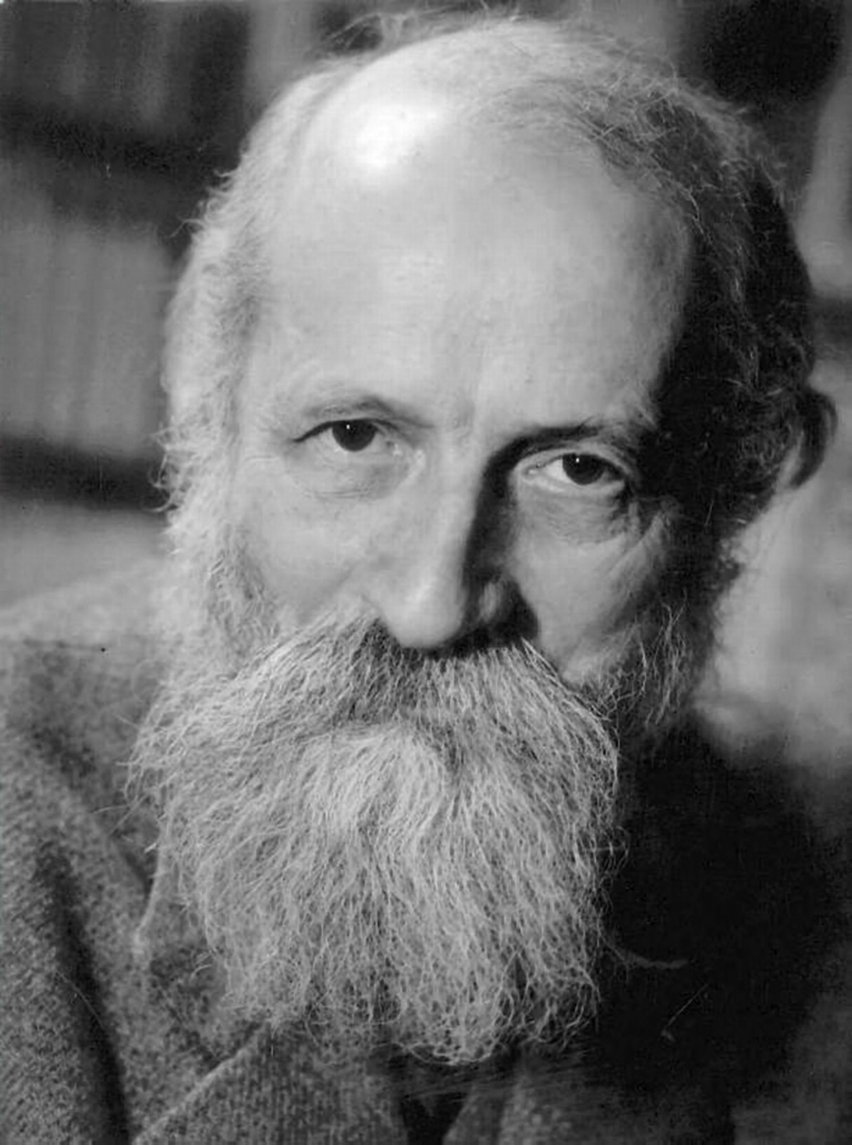
Educational Thoughts of Martin Buber
Theory of learning: A genuine speaking and listening is essential for all the true communication for truly effective learning and ultimately for the entire pursuit of truth.
Theory of transmission : Cultural and spiritual heritage should be transmitted to children.
Theory of Society: Creating community spirit
Theory of opportunity : Grow aware of the world.
Theory of value: Children must be taught to explore their “two autonomous instincts”
Objective knowledge Active Knowledge
Theory of knowledge: knowledge of self and knowledge of reality needed.
Theory of human nature: Freedom for self development and growth of human.
Dr. V. Regina , Principal CSI BISHOP NEWBIGIN COLLEGE OF EDUCATION

Slide 15
Educational Thoughts of Martin Buber
Children are not the people of tomorrow, but people of today.
They should be allowed to grow into whoever they were meant to be.
They are entitled to be taken seriously.
Experiential learning is more than just a series of experience that a learner undergoes.
The learner is the primary focus of the learning.
The teacher instructor.
Education is not the preparation for life ; Education is life itself.
Dr. V. Regina , Principal CSI BISHOP NEWBIGIN COLLEGE OF EDUCATION

Slide 16
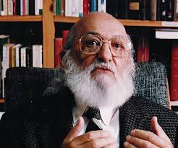
Educational Thoughts of Paulo Freire
Pedagogy of Hope - Reading the word cannot be the word.
Pedagogy of the freedom - Educational practice a communication.
The politics of education: Education is always a political act cannot be neutral.
Dialogue as a pedagogical tool.
Education as practice of freedom - learning begins with action.
Pedagogy of the oppressed - Education is a cultural tool for liberation from oppression.
Education for critical consciousness, critical understanding of reality.
Dr. V. Regina , Principal CSI BISHOP NEWBIGIN COLLEGE OF EDUCATION

Slide 17
Educational Thoughts of Paulo Freire
Egalitarian teacher - student relations.
Education for liberation.
Education for conscientization
Education for posing education..
Transformative social justice learning .
To Act - To Analyse - To Act : are the methodology.
Find the problems.
Produce the codes - create a play or skit.
Dr. V. Regina , Principal CSI BISHOP NEWBIGIN COLLEGE OF EDUCATION

Slide 18
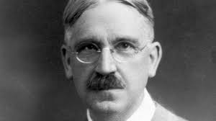
Educational Thoughts of John Dewey
The role of a teacher is more like a facilitator than an instructor..
Experiential Education.
Enquiry based Education .
Instrumentalism.
Progressive Education - Learning through “hands-on” approach learning by doing pragmatism.
Learning emphasis is the needs and interests of the child..
Children should be allowed to explore their environments.
Dr. V. Regina , Principal CSI BISHOP NEWBIGIN COLLEGE OF EDUCATION

Slide 19
Educational Thoughts of John Dewey
Students should be actively involved in real-life tasks and challenges.
Experimental school..
Curriculum - centered view of education rejected and interests and experiences of students accepted..
Reflect social life.
Teacher facilitator and guide.
Existentialism, Behaviorism, Constructivism his philosophies of education.
Problem solving method of learning
Define
Analyze
Determines
Propose
Evaluate
Select
Implement.:
Dr. V. Regina , Principal CSI BISHOP NEWBIGIN COLLEGE OF EDUCATION

Slide 20
The utilization of knowledge will often occur in subsequent learning situations within the school itself and the competences acquired by the child will often be the skilled use of concepts, facts and principles as well as the mastery of motor skills.
Learning by doing is essential to the acquisition knowledge as a personal possession of each and every individual.
Conclusion
Dr. V. Regina , Principal CSI BISHOP NEWBIGIN COLLEGE OF EDUCATION

Slide 21

Suggestive Readings
Fagg.H(2006), A stuy of Gandhi’s Basic Education, New Delhi: National Book Trust.
Mark K. Smith, ” Martin Buber on education”. The encyclopedia of informal education(2000)
hhtp://www.visva.bharati.com:
Dr. V. Regina , Principal CSI BISHOP NEWBIGIN COLLEGE OF EDUCATION

